Slide 1
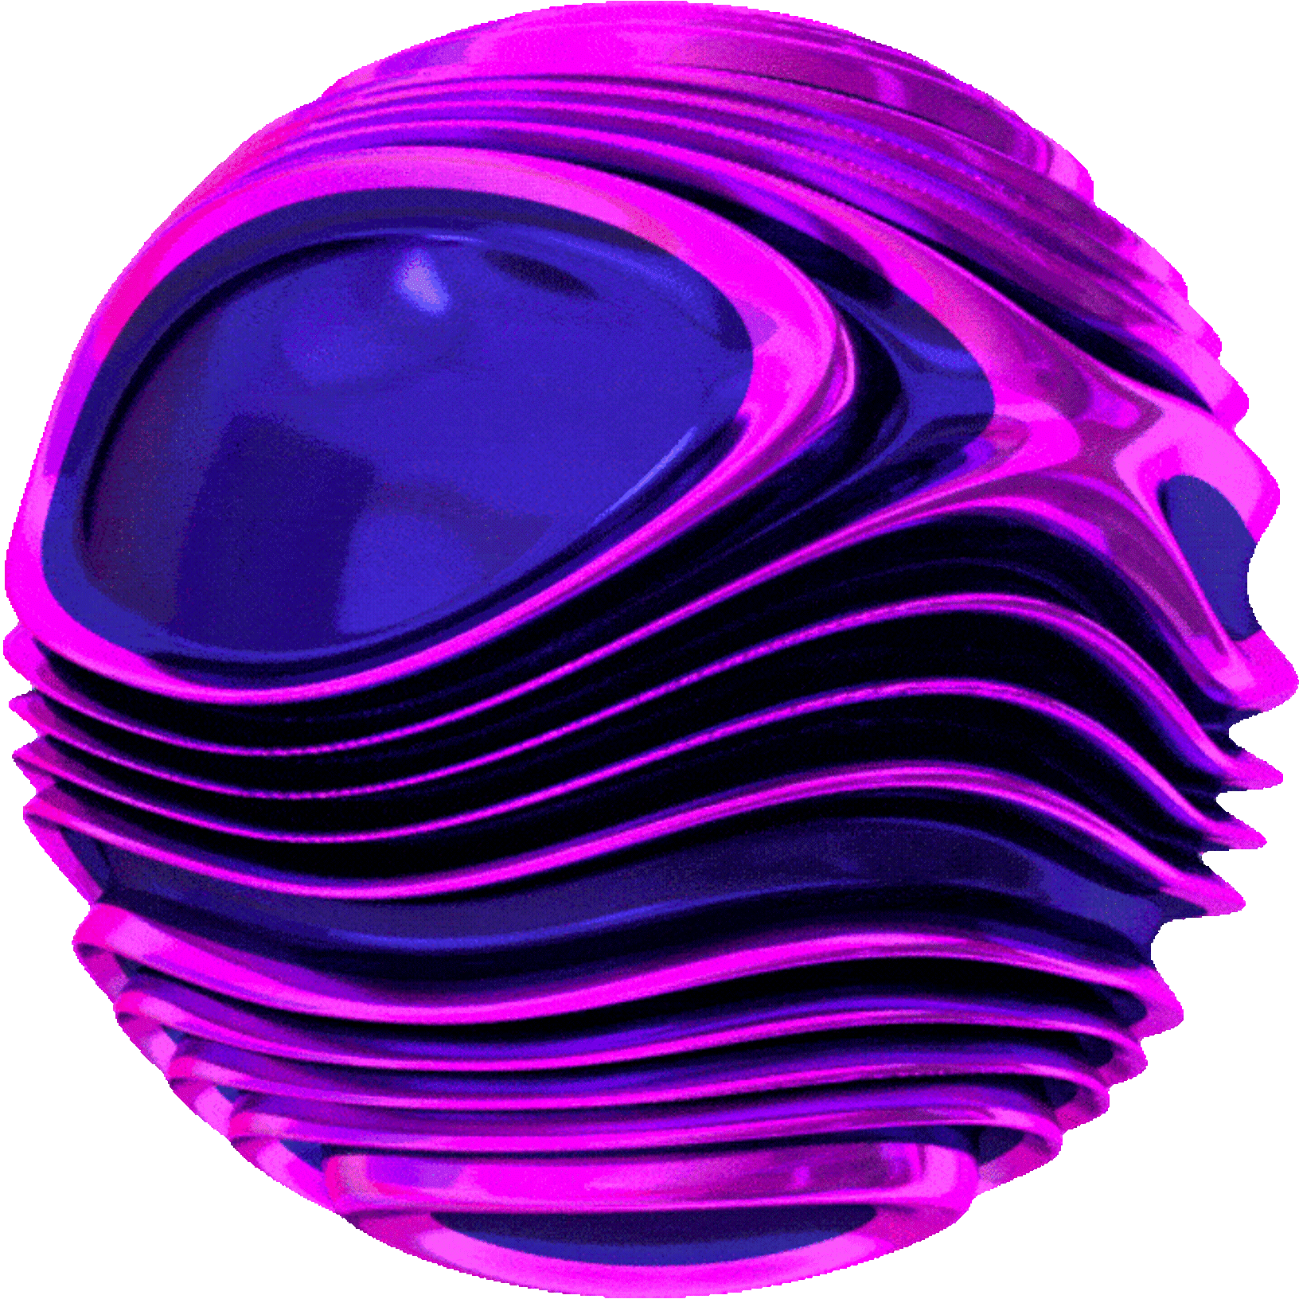
BreaQ
Entangled Machine Learning

Slide 2
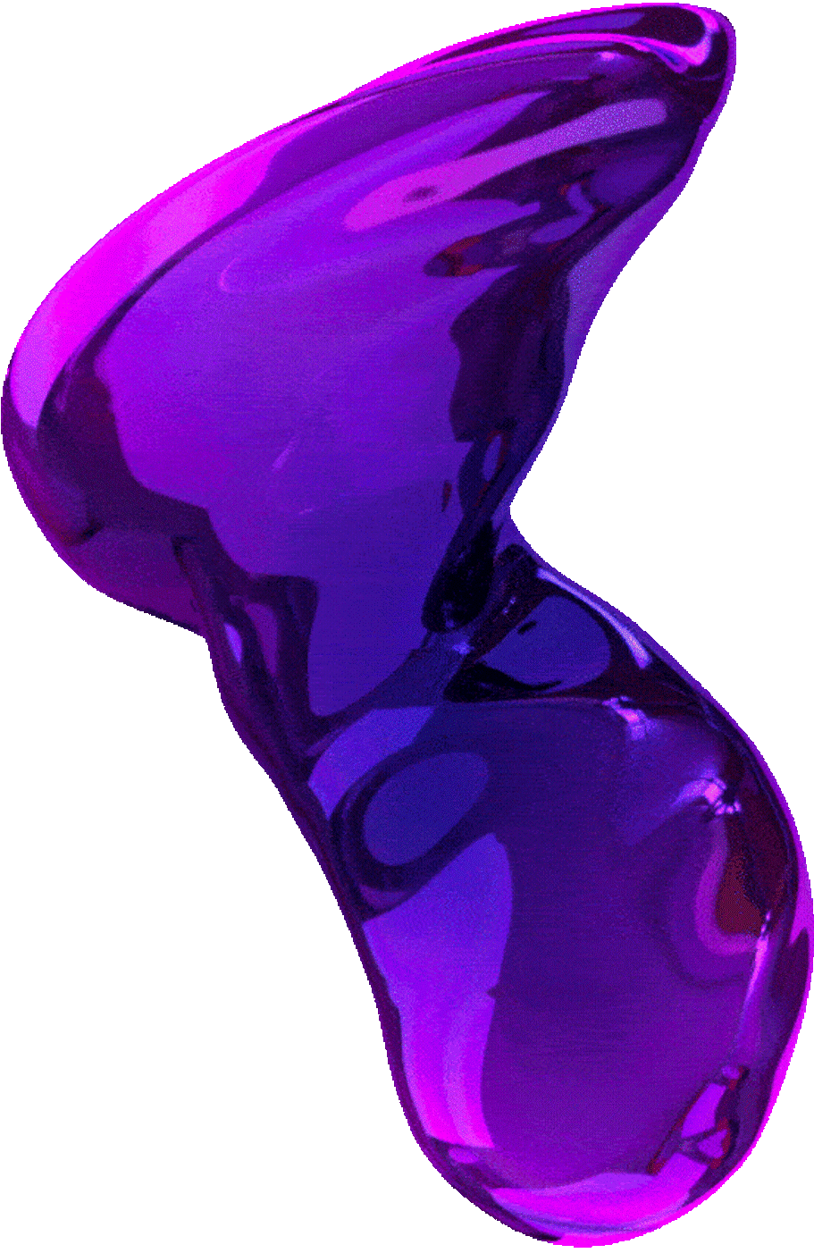
Track 1 - The Expressivity Experiment
Content: Quantum Circuit Design
Architecture: Data Re-uploading (Sandwich model).
Components: StronglyEntanglingLayers + AngleEmbedding (looped 4 times).
Rationale: Re-encoding data between variational layers allows the circuit to approximate complex non-linear functions with fewer qubits.
Methodology
Pre-processing: Images resized to 64x64.
Training: End-to-end hybrid training; the quantum layer acts as the final classifier.
Hypothesis: Increasing the depth of data insertion improves expressivity without needing more qubits.
Results
High expressivity achieved with low circuit depth (2-4 layers).

Slide 3
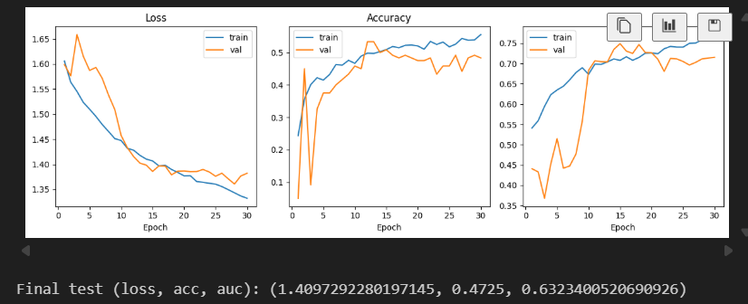

Slide 4
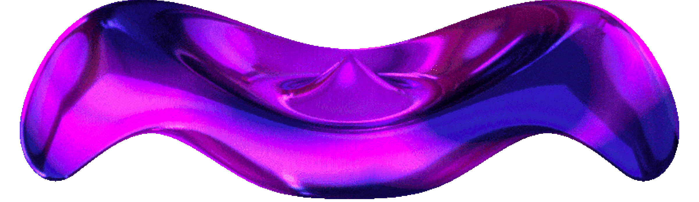
Track 2 - The Vision Experiment - proof of concept
Content: Quantum Circuit Design
Architecture: Quanvolutional Neural Network (QNN).
Components: QuanvolutionLayer (2x2 kernel, stride 2) placed at the start of the network.
Rationale: Uses quantum Hilbert space transformations as feature extractors (edge detectors) orthogonal to classical filters.
Methodology
Pre-processing: Images converted to Grayscale and resized to 28x28 due to computational cost.
Encoding: 2x2 pixel patches mapped to 4 qubits via AngleEmbedding.
Training: Quantum output (4 channels) feeds into a classical CNN backbone.
Results
Successfully functioned as a pre-processing filter, though computationally expensive to simulate, not enough resources to simulate properly

Slide 5
Track 3 - The ResQ-Net (Residual Hybrid)
Content: Quantum Circuit Design
Architecture: Residual Parallel Architecture (Classical + Quantum).
Components: BasicEntanglerLayers (2 layers) running parallel to a classical linear projection.
Rationale: Avoids the Quantum Information Bottleneck by learning a weighted sum of predictions.
Methodology
Training: Uses a learnable scalar Alpha: Output = Classical + (Alpha * Quantum).
Metric: Monitor Alpha magnitude to verify quantum contribution.
Ablation: Compared against Alpha=0 (Classical Only baseline).
Results
Alpha converged to 1.03, proving the active use of the quantum signal.
Accuracy improved from 43.25% (Classical) to 48.00% (Hybrid).

Slide 6
Track3 - extra
Track 3 splits the CNN output into two paths:
• Path A: CNN → Classical Linear
• Path B: CNN → Quantum Circuit
Final Output = Path A + (Alpha × Path B)
This lets the classical path stay reliable while the quantum path acts as a helper/corrector.

Slide 7
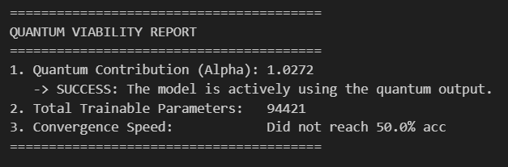
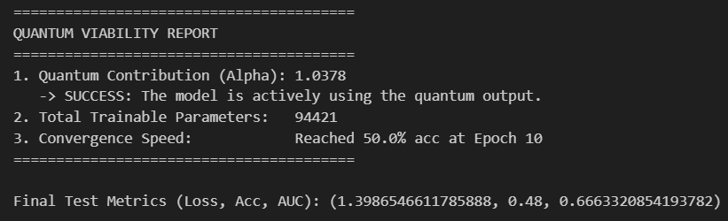
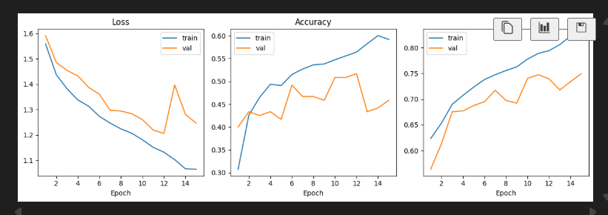
track3 - 20 percent training size
track3-full scale run

Slide 8
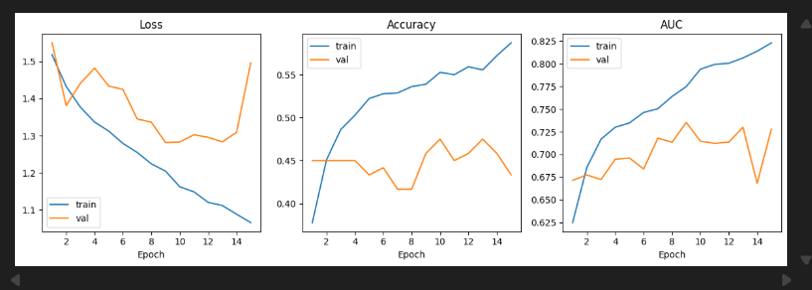
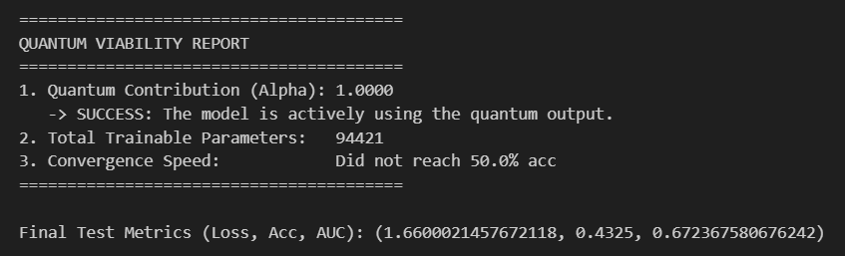
track3-ablation baseline - alpha = 0 influence

Slide 9
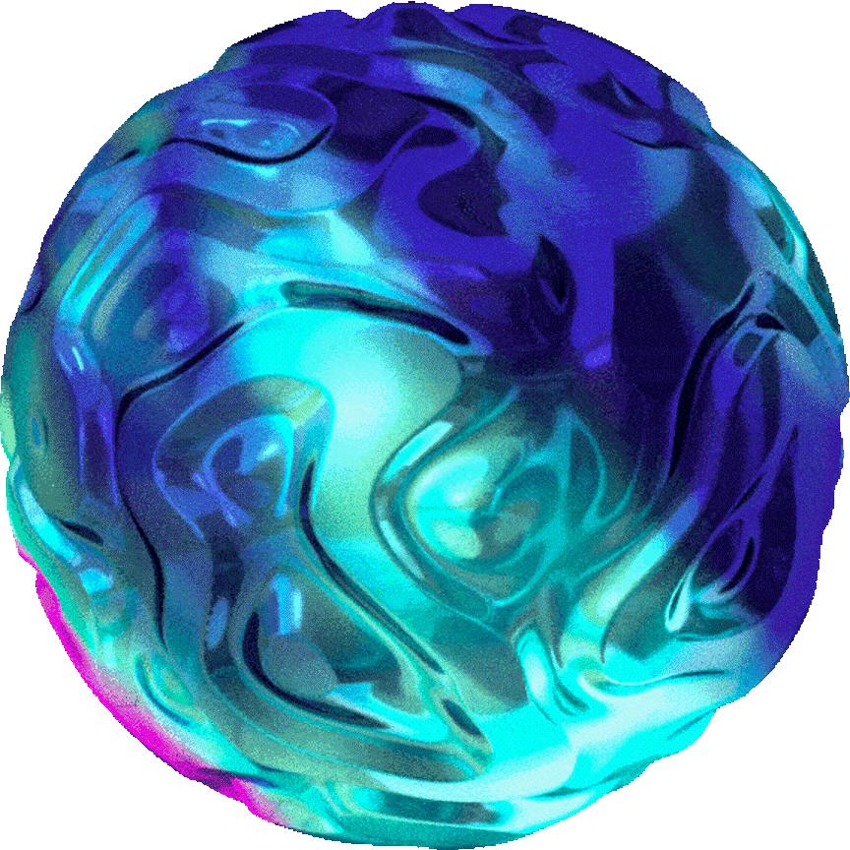
Track 4 - The Balanced Experiment
Architecture: High-Dimensional Projection.
Components: 6 Qubits for 3 Classes (creating a 64-dimensional Hilbert space).
Rationale: A larger Hilbert space improves the linear separability of the encoded data.
Methodology
Data Engineering: Filtered dataset to distinct classes only (0: Normal, 2: Moderate, 4: Proliferative).
Balancing: Used WeightedRandomSampler to counter class imbalance.
Hypothesis: Removing noisy intermediate classes (1 & 3) and balancing data maximizes hybrid model stability.
Results
Achieved highest stability and reduced variance by combining rigorous data engineering with quantum projection.

Slide 10
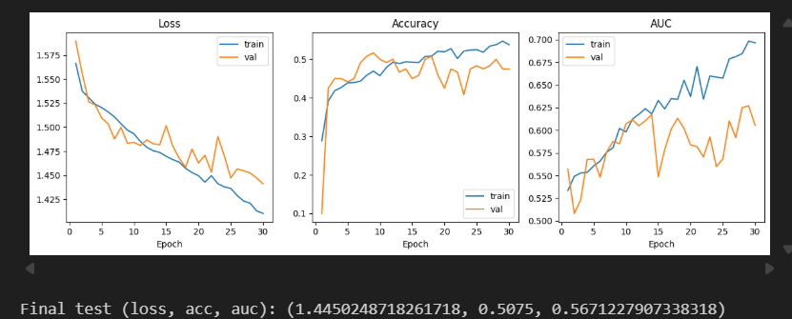
track4-balanced data set ;classes 0,2,4 from classes 0-4

Slide 11
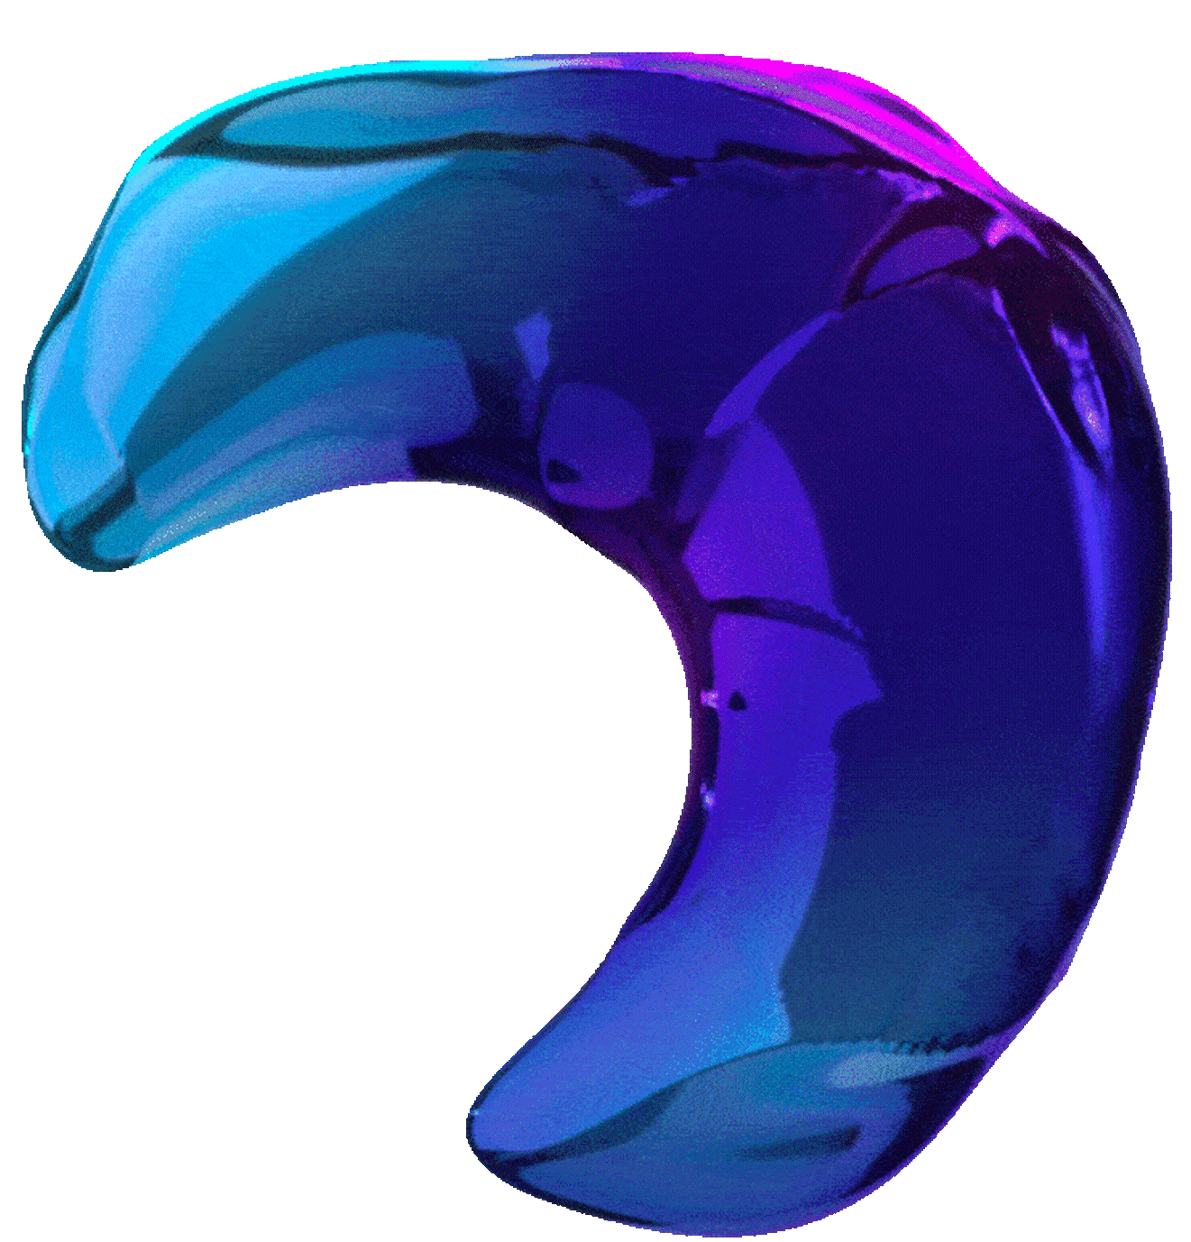
Track 5 - The "Density" Experiment (Amplitude Embedding)
Architecture: Amplitude Encoding via Hybrid CNN.
Components: AmplitudeEmbedding + BasicEntanglerLayers.
Rationale: Amplitude embedding allows encoding 2^N classical features into N qubits. We encode 32 dense features into just 5 qubits.
Methodology
Pre-processing: Images resized to 64x64, then processed by a classical CNN.
Encoding: CNN output is projected to a vector of size 32, normalized, and mapped to the amplitudes of the quantum state.
Training: End-to-end training of the CNN feature extractor and the quantum classifier.

Slide 12
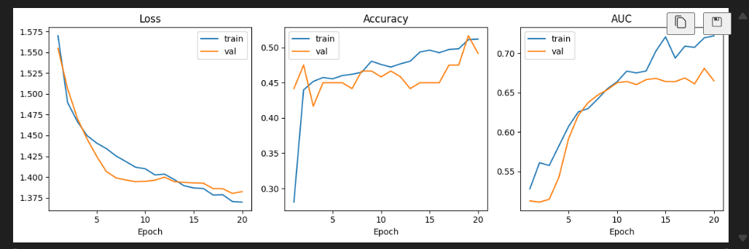

Slide 13
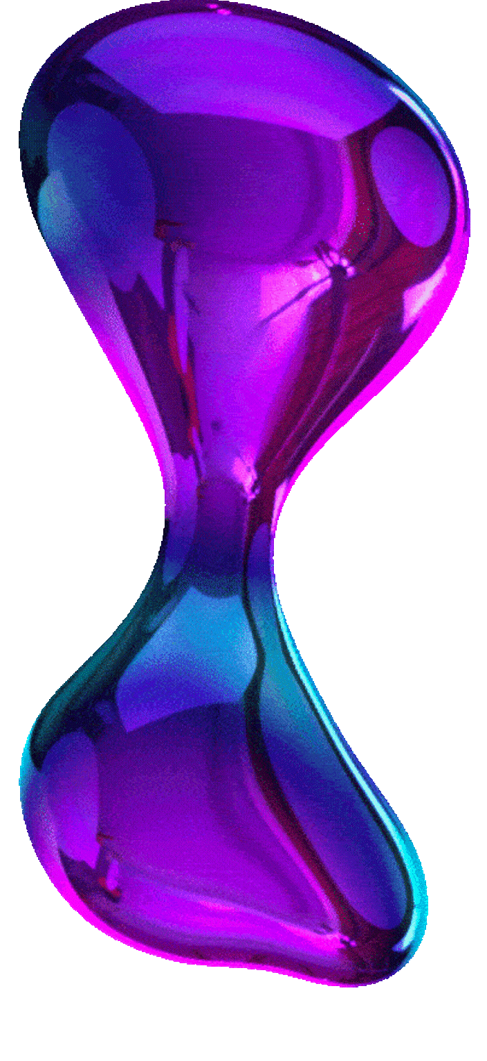
Track 6 - The "Ghost" Experiment (PCA Compression)
Architecture: PCA-Quantum Hybrid.
Components: 6 Qubits (64 Amplitudes) using StronglyEntanglingLayers (3 layers).
Rationale: Using Principal Component Analysis (PCA) to mathematically reduce image noise and dimensions before the quantum stage.
Methodology
Pre-processing: 28x28 images flattened to 784 vectors.
Encoding: Scikit-Learn PCA reduces data to 64 components (8x8 "Ghost Images"), fed into AmplitudeEmbedding.
Training: The PCA encoder is frozen (pre-calculated); only the quantum layers and a final scaling layer are trained.

Slide 14
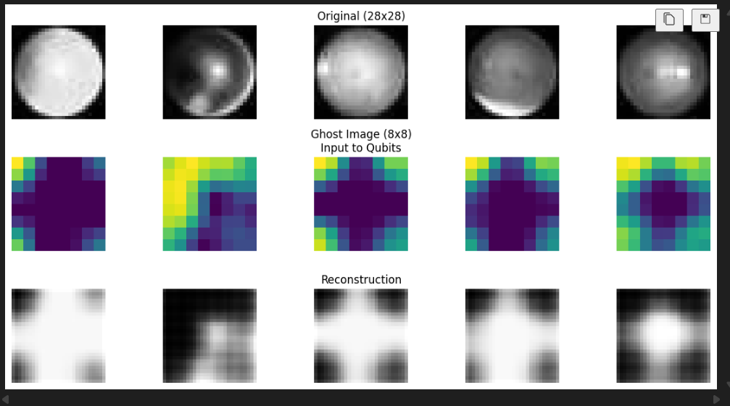
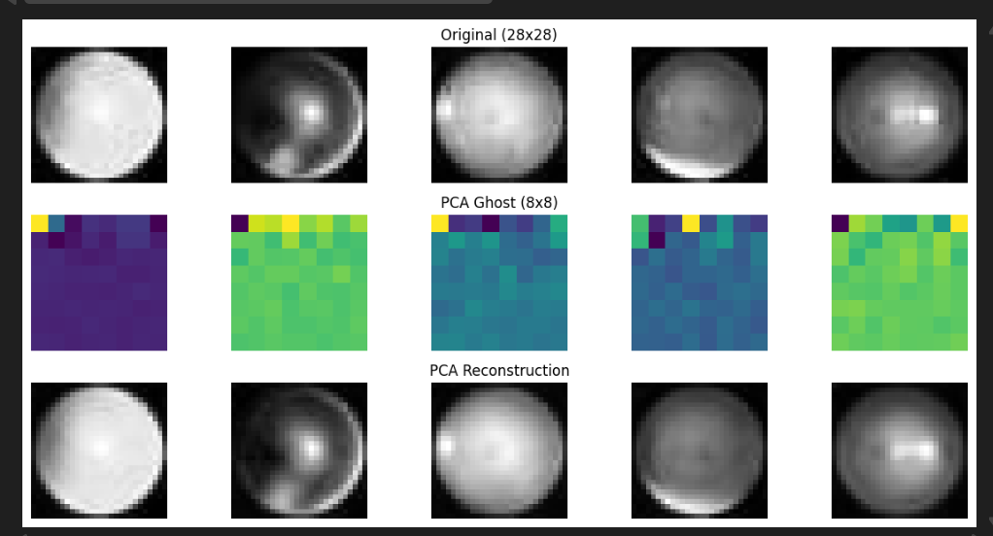
ClassicalAutoencoder
PCA ENCODE/DECODE

Slide 15
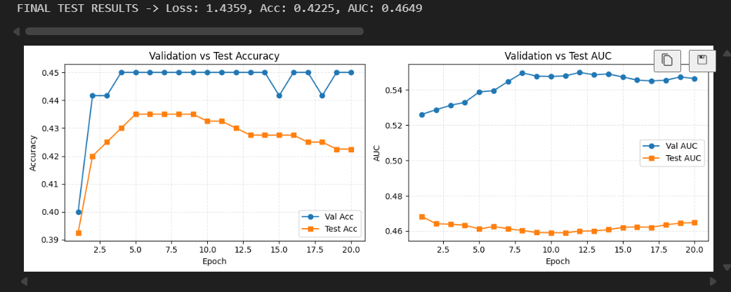

Slide 16
Track 7 - The "Learned Compression" Experiment (NN Encoder)
Architecture: Trainable CNN-to-Quantum Auto-Encoder.
Components: 6 Qubits (64 Amplitudes) using StronglyEntanglingLayers.
Rationale: Unlike PCA (linear), a neural network encoder captures non-linear spatial features and compresses them into a quantum state vector.
Methodology
Pre-processing: 28x28 Grayscale images.
Encoding: A custom CNN "Encoder" block forces the output dimension to exactly 64 features to fit the Hilbert space of 6 qubits.
Training: End-to-end gradient descent (The encoder learns to compress specifically for the quantum circuit).

Slide 17
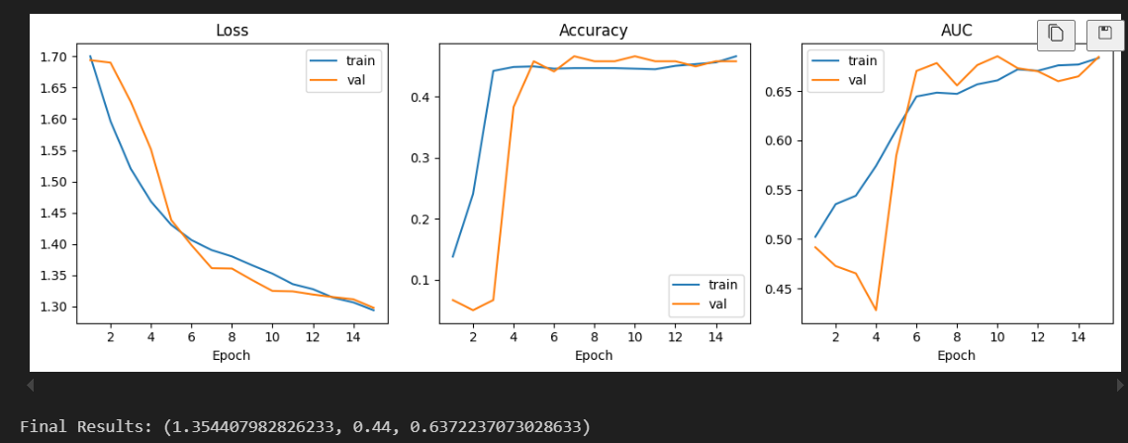

Slide 18
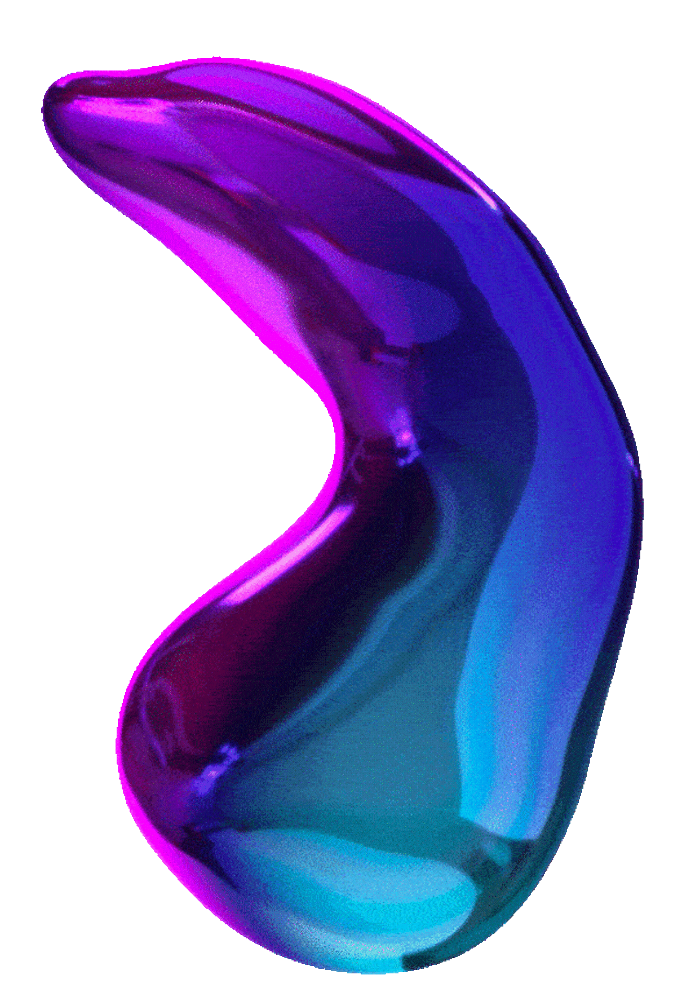
Track 8: Data Re-uploading & Data Efficiency - comparison
Focus: Maximizing Expressivity & Generalization
Architecture: HybridCNN
Design: Standard CNN followed by a highly expressive quantum layer that acts directly as the classifier (n_qubits = num_classes).
Data Re-uploading: Instead of embedding data once, the input features are encoded into the circuit 3 separate times
Experimental Method:
Data Sweep: Trained both Classical and Quantum models on partial datasets: 10%, 30%, 50%, 80%, and 100% to see how they perform compared to one another

Slide 19
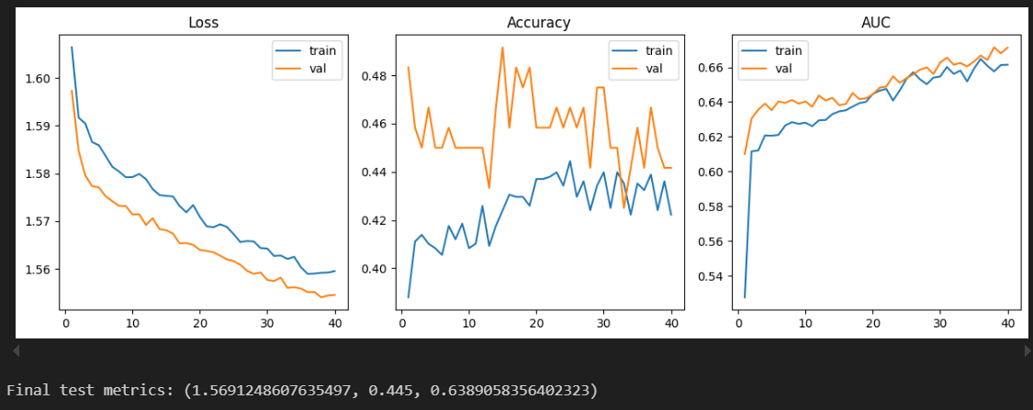
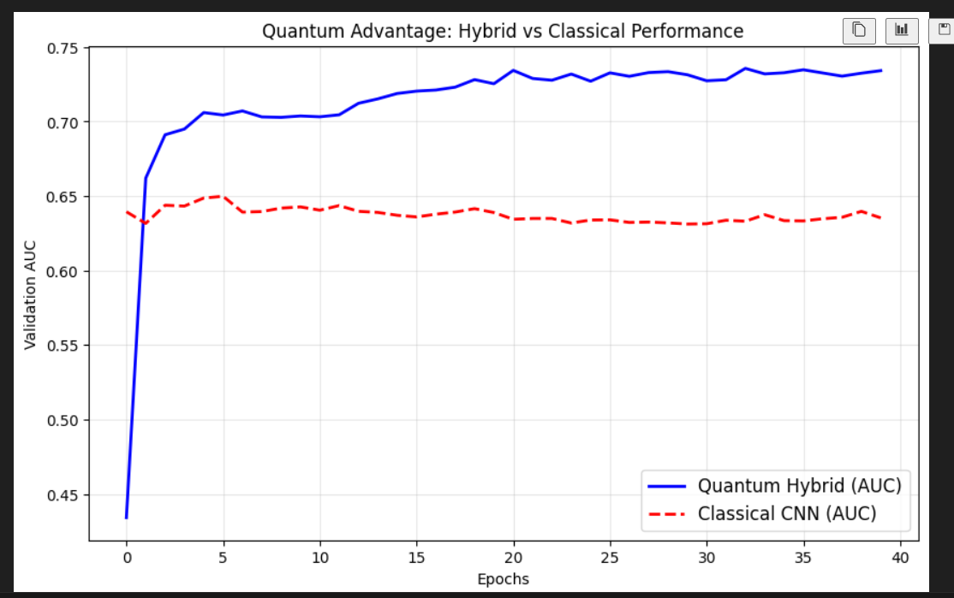

Slide 20
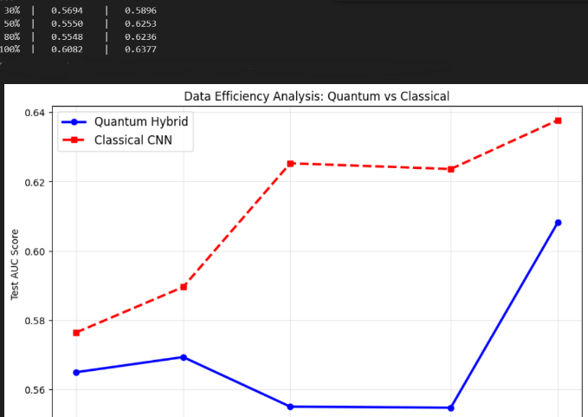

Slide 21
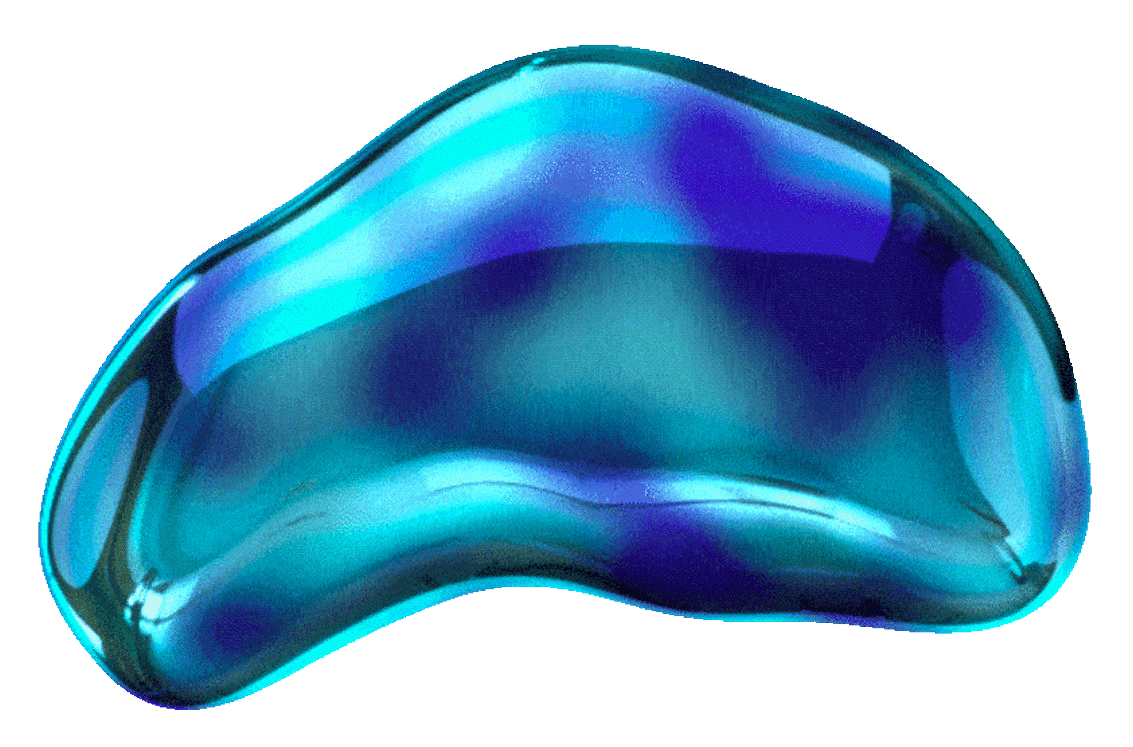
Track 9: Transfer Learning with HResNet - comparison
Focus: State-of-the-art Classical Features + Quantum Head
Architecture: HybridResNet
Backbone: ResNet18 (Pre-trained on ImageNet) with frozen weights used purely as a feature extractor.
Interface: A classical Linear layer reduces the 512 ResNet features to 4, followed by a Tanh activation.
Quantum Head: A 4-qubit variational circuit replaces the final fully connected layer.
Circuit Design: 2 layers of StronglyEntanglingLayers with AngleEmbedding (Y-rotation).
Data Handling: Unlike the other models, this uses RGB images resized to 128x128 to match ResNet requirements.

Slide 22
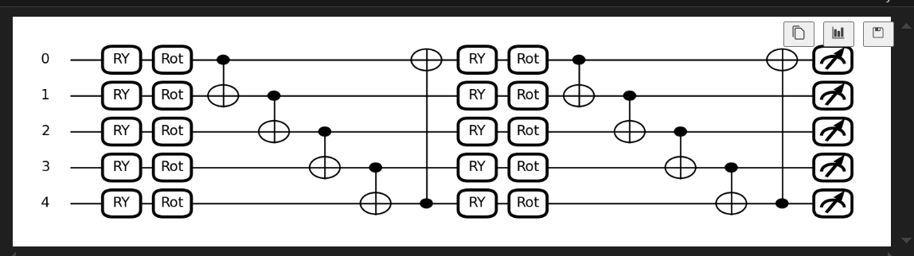
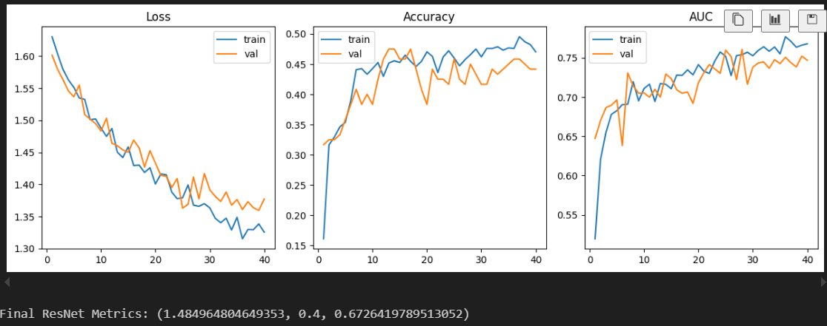

Slide 23
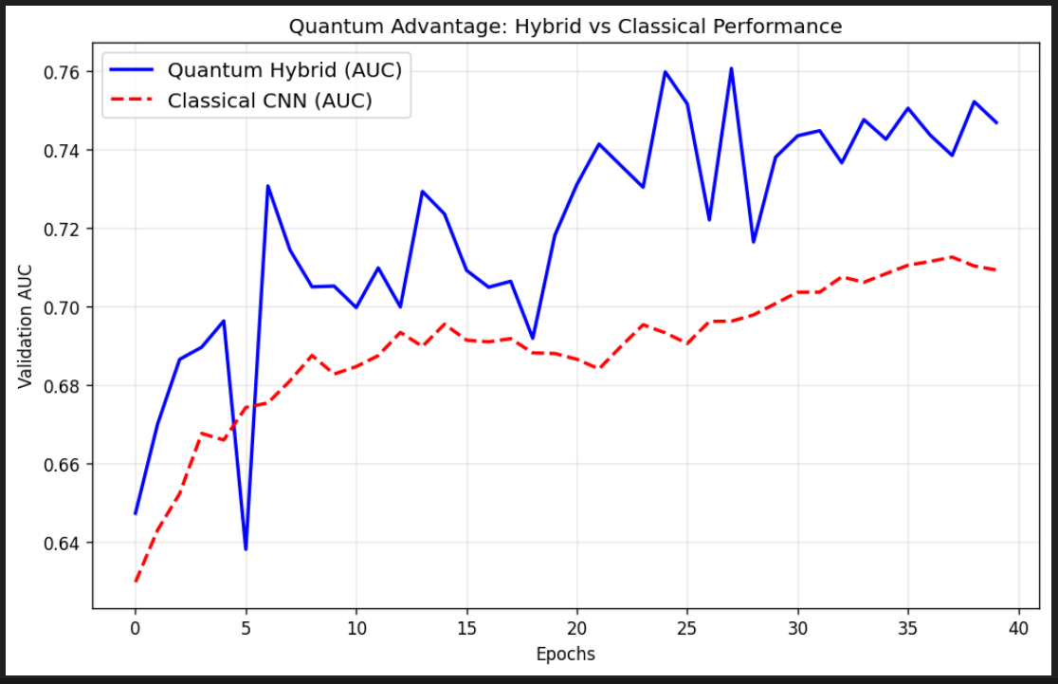
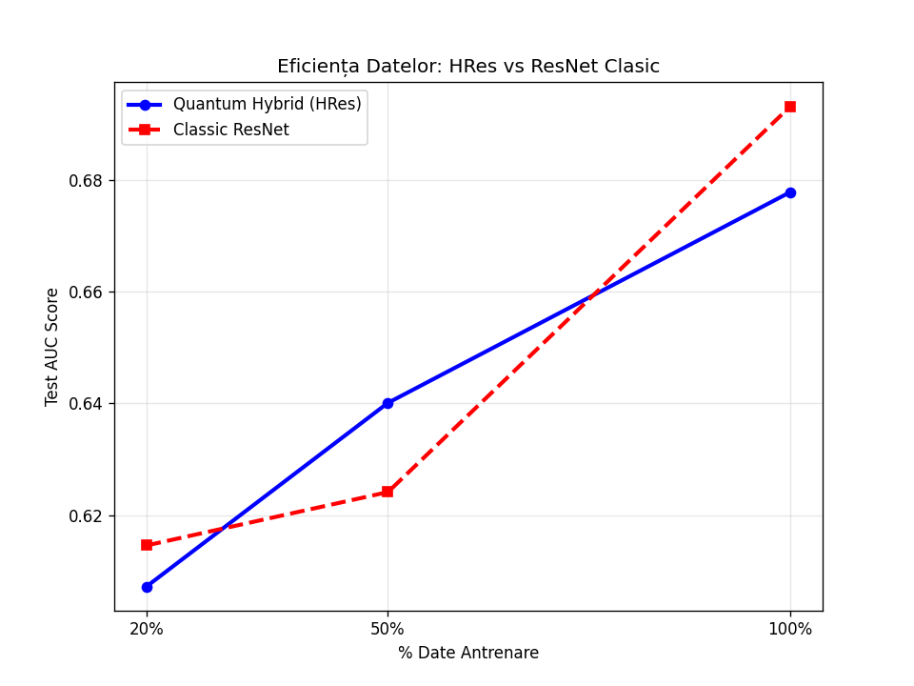

Slide 24
Track 10: Parallel Hybrid Architecture
Focus: Distributed Quantum Processing
Architecture: ParallelHybridCNN
Classical Body: Custom CNN extracts 64 features, reduced to 6 by a Linear layer.
Quantum Layer: The 6 features are split into 3 pairs (x_1, x_2, x_3).
Parallel Execution: 3 independent quantum circuits run in parallel, each utilizing 2 qubits.
Recombination: Outputs are concatenated and fed to a final linear classifier.
Circuit Design: Uses AngleEmbedding for encoding and BasicEntanglerLayers for variational processing on 2-qubit blocks.

Slide 25
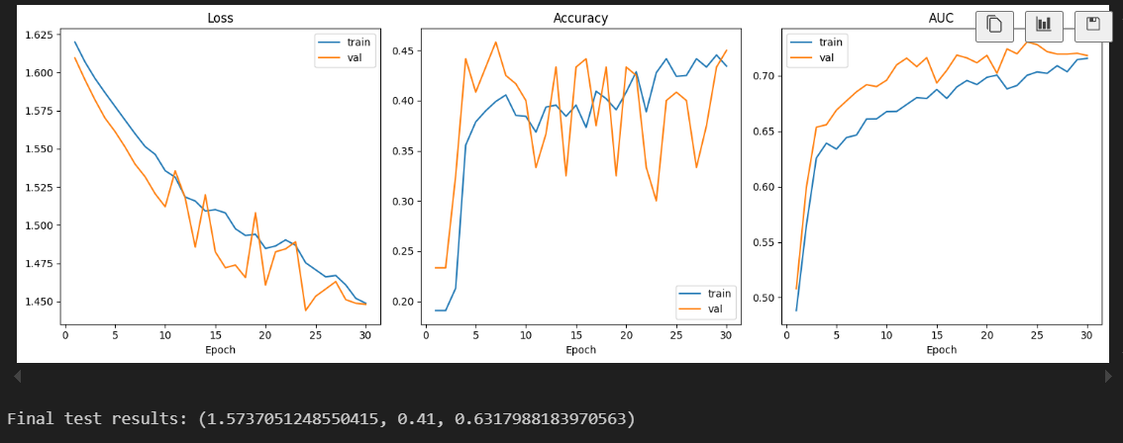

Slide 26
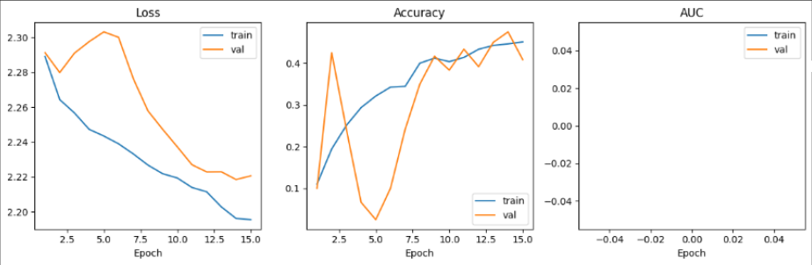
Consequence of using a lot of qubits
If we were to increase the number of qubits by a lot, the accuracy drastically goes down.
Additionally we see Barren Plateau effect where AUC becomes useless since it stabilises on 0.5 or worse than initial performance.This happens become the gradient function of quantic parameters is getting close to 0

